Slide 1

AI Engineer Agentic Track
The Complete
Agent & MCP
Course
Week 4
Day 5

Slide 2
Week 6: MCP
Agentic
Architecture
and MCP
Building an
MCP Server
and Client
Multiple Local
and Remote
MCP servers
Project 8: AI
Equity Traders
Project 8: AI
Equity Traders
In Action
Week 5: Agent Frameworks
Google ADK and A2A
AWS Strands Agents
Other Python Frameworks
JS/TS Frameworks
Project 7:
Agent
Loop
Week 4: LangGraph
LangChain Core
LangGraph
LangChain
create_agent
Deep Agents
Project 6:
Sidekick
Week 3: CrewAI
Understand
Crew AI
Concepts
Build a Crew
Agent
Project 4: Stock
Picker
Project 5:
Developer
Agent
Project 5:
Engineering
Team
Week 2: OpenAI Agents SDK
Understand
OpenAI Agents
SDK concepts
Project 2: an
SDR
Tools vs Agents
Guardrails
Project 3: Deep
Research
Project 3: Deep
Research app
Week 1: Foundations
Make an
Agentic
Workflow
Agents and
Agentic
Patterns
Orchestrating
LLMs
Autonomy and
Tools
Project 1:
Your personal
career agent

Slide 3
Recap: the abstraction layers
Four levels: control at the bottom, convenience at the top
Layer 4 Harness
Planning, sub agents, a filesystem; you supply intent
deepagents
Layer 3 Agent
The agent loop prebuilt; you supply model, tools and prompt
langchain
TODAY
Layer 2 Orchestration
StateGraph, nodes, edges, checkpoints; you control the flow
langgraph
Layer 1 Building blocks
Models, messages and tools; you control everything
langchain-core

Slide 4
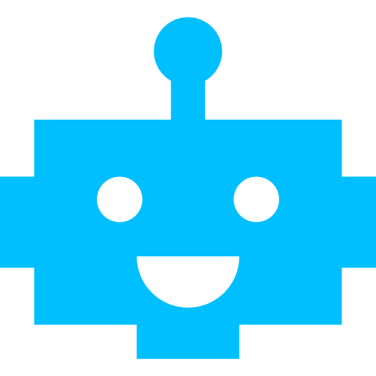




Our Journey
The worker one create_agent carrying every tool, with a memory
A visible plan middleware gives it a todo list; watch it tick along live in the app
Guardrails PII redaction and a hard budget cap, each one line of middleware
Human-in-the-loop it pauses for your approval, and can hand you the browser
The evaluator your own loop judges each reply against your success criteria

Slide 5



The Sidekick
Project 6: the classic agentic use case
Your co-worker brief it with a task and your definition of success
Autonomous it plans, uses tools, checks its work and keeps going
Real-world tools a live browser, a filesystem, search and push notifications

Slide 6
End of week challenge
Make the Sidekick yours
Specialize it rebuild the Sidekick for your business domain and your daily work
A specialist prompt bake your domain know-how into the worker's instructions
Specialist tools swap in the tools of your trade: your APIs, your data, your systems
Showcase it a domain Sidekick is a compelling portfolio piece; share what you build

Slide 7
Week 6: MCP
Agentic
Architecture
and MCP
Building an
MCP Server
and Client
Multiple Local
and Remote
MCP servers
Project 8: AI
Equity Traders
Project 8: AI
Equity Traders
In Action
Week 5: Agent Frameworks
Google ADK and A2A
AWS Strands Agents
Other Python Frameworks
JS/TS Frameworks
Project 7:
Agent
Loop
Week 4: LangGraph
LangChain Core
LangGraph
LangChain
create_agent
Deep Agents
Project 6:
Sidekick
Week 3: CrewAI
Understand
Crew AI
Concepts
Build a Crew
Agent
Project 4: Stock
Picker
Project 5:
Developer
Agent
Project 5:
Engineering
Team
Week 2: OpenAI Agents SDK
Understand
OpenAI Agents
SDK concepts
Project 2: an
SDR
Tools vs Agents
Guardrails
Project 3: Deep
Research
Project 3: Deep
Research app
Week 1: Foundations
Make an
Agentic
Workflow
Agents and
Agentic
Patterns
Orchestrating
LLMs
Autonomy and
Tools
Project 1:
Your personal
career agent

Slide 8

AI Engineer Agentic Track
The Complete
Agent & MCP
Course
67%
Complete

